Slide 1

ABAP RESTful Application Programming Model

Slide 2

Einführung
Erläuterung des Konzeptes

Slide 3

Functions of a programming model
Which development objects are used to realise a specific application or functionality, and what functions do these development objects have?
How are these development objects related and how do they build on each other (i.e. what are the dependencies between the development objects)?
Which programming interfaces (APIs) are available to realise typical application requirements or specific functionalities?

Slide 4
REST architecture principles
Statelessness REST is based on the principle of statelessness. Each request from a client to the server must be self-contained and complete. The server does not store any context information across different requests.
Standardised Interface REST requires a standardised interface for communication between client and server. This interface makes it possible to address and change resources via URLs without encoding method information in the URLs.
Client-Server-Architectur REST defines a clear separation between client and server. Servers provide services, while clients can use them. Communication takes place via standardised protocols such as HTTP.
Layering REST allows the layering of systems, whereby client and server components can be arranged in different layers. The client does not need to know whether a response comes from the original server or a server in a middle layer.
Caching REST enables the buffering of server responses (representations) with metadata in order to reduce the network load and improve response times. If a representation can be buffered, it can be reused as a result for similar client requests.

Slide 5
Technological innovations with SAP S/4HANA
SAP-HANA-Database
Core Data Services (CDS)
SAP Gateway und Odata
SAP Fiori UI
SAP Fiori Launchpad

Slide 6
Evolution of ABAP-based programming models
Classic application development with ABAP
Business Object Processing Framework (BOPF)
ABAP RESTful Application Programming Model (RAP)

Slide 7
Einführung
Erläuterung der Architektur

Slide 8
RAP transaction model
Interaction phase
In this phase, operations are performed on a business object instance. Examples include creating or changing an item.
The instances of the respective CDS entities are held in the transaction buffer.
Memory sequence
After the interaction phase, the storage sequence is triggered by a commit.
The state of the transaction buffer is persistently written to the database.
The transaction buffer stores instances of CDS entities that have been created, changed or deleted (modify).
The transaction buffer is not retained across multiple requests in order to maintain the REST principle of stateless communication.
Draft handling in the RAP makes it possible to temporarily store the state of the transaction buffer with inconsistent application data in the database. This allows users to continue their work independently of the end device. The RAP runtime fully implements this functionality.

Slide 9
Implementation types
Managed Scenario:
In the Managed Scenario, you use a ready-made implementation of the business object, the Managed BO Provider, which is provided by the RAP.
The Managed BO provider realises standard operations such as creating, reading, updating and deleting instances of the respective CDS entity during the interaction phase and the storage sequence (CRUD).
Handling the transaction buffer is also part of the managed scenario.
Optionally, you can add further logic to the save sequence (Additional Save) or implement it yourself (Unmanaged Save).

Slide 10
Implementation types
Unmanaged Scenario:
In the unmanaged scenario, you can implement the standard functionality of a business object yourself.
This applies to both the interaction phase with the transaction buffer and the storage sequence.

Slide 11
Entity Manipulation Language
The Entity Manipulation Language (EML) is a standardised, type-safe API that is firmly anchored in the ABAP language scope. It enables access to data and functionalities of business objects. Here are the most important aspects of EML:
MODIFY ENTITIES
READ ENTITIES
...
See documentation in the GIT

Slide 12
Introduction
SAP Clean Core Model

Slide 13
SAP Clean Core Model
The SAP Clean Core Model is a concept that aims to ensure the integrity and efficiency of SAP S4/Hana systems.

Slide 14
SAP Clean Core Model
Three tier model
Cloud expansion model (Tier 1)
Cloud-API-Enablement (Tier 2) Hierbei werden APIs genutzt, um externe Anwendungen mit der Cloud zu verbinden und zusätzliche Funktionalitäten bereitzustellen.
Classic ABAP extensions (Tier 3)
Overall, the Clean Core Model aims to maintain system integrity, enable efficient upgrades and minimise the complexity of extensions.

Slide 15
Einführung
Grundlagen der RAP Implementierung

Slide 16
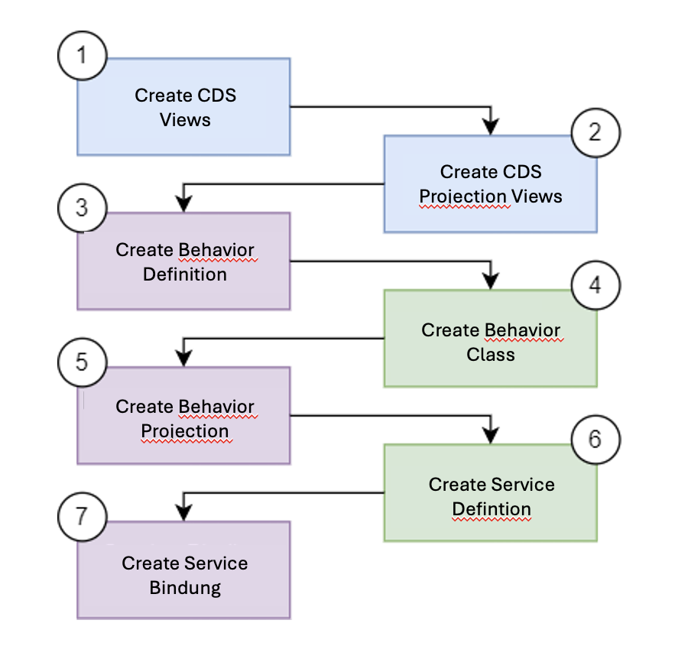
RAP Implementierungs-Workflow

Slide 17

Info
The source texts for the exercises or sample solutions can be found in GitHub.

